Slide 1
Wordle Assistant
A Python program to assist in solving Wordle puzzles
Hamilton Python Users Group
Ian Stewart
14 Feb 2022

Slide 2
Wordle Assistant ~ Presentation Contents:
Demonstration using the program crossword_cracker.py
Introduction to Wordle
Jimmy Fallon ~ Wordle video clip
Summary of the rules of deducting from the list of possible words.
Wordle Assistant reviewing Jimmy Fallon choices of words.
Games that start by eliminating all vowels and Y.
  Jimmy Fallon
  11 Feb 2022 Game
  Game with all Orange.
Utilities examples
Python code snippets
Play todays Wordle game
Wordle Assistant ~ wordle_assistant.py: https://github.com/HamPUG/meetings/tree/master/2022/2022-02-14

Slide 3
crossword_cracker.py
Demonstration of Python program that wordle assistant is derived from.

Slide 4
Wordle
Wordle is a web-based word game developed by Josh Wardle.
The game is played once each day. Each day has a new word to solve.
Wardle initially created the game for himself and his partner to play, eventually making it public in October 2021.
Recently the game was purchased by The New York Times Company.
Original website: https://www.powerlanguage.co.uk/wordle/
New website: https://www.nytimes.com/games/wordle/index.html
Total words 12,972. (USA spelling?). Linux English words 5 letter 4,653
54 Words do not have: AEIOU. E.g. crypt, cysts, gypsy, hymns, synth, wryly.
Also no vowels or Y: “crwth”, “cwtch”, “grrls”, “grrrl”, “phpht”.

Slide 5
Jimmy Fallon. Example of playing Wordle.
The Tonight Show ~ Wordle Video clip (7m 24s): https://www.youtube.com/watch?v=QcZWd75Ph4Q

Slide 6
Rules: Reducing possible words from list of 12,962
Dark Grey: Letter is not in the word.
  All words can be scanned for this letter in any position and removed from list of possible words.
Yellow or Green:
  All words that do not have this letter may be removed from the list of possible words.
Yellow: Letter is in the word, but not at this position.
  All words that have this letter at this position may be removed from the list.
  May be multiple letters at a certain position that are not in the correct place.
Green: Letter is in the word at this position.
  All words that do NOT have this letter at this position may be removed from the list.
  Only this letter can be at this position.

Slide 7
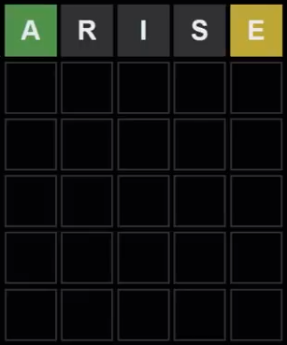
Jimmy Fallon: First Word
ian@hp:~$ python wordle_assistant.py
Total words is: 12972
Enter the letters NOT in the word ~ Dark Grey:ris
Total words remaining: 3120
Enter the letters in the word ~ Yellow and Green:ae
Total words remaining: 615
Yellow letters:
1st position in the word [ a e ]:
2nd position in the word [ a e ]:
3rd position in the word [ a e ]:
4th position in the word [ a e ]:
5th position in the word [ a e ]:e
Total words remaining: 399
Green letters:
1st position in the word [ a e ]:a
2nd position in the word [ a e ]:
3rd position in the word [ a e ]:
4th position in the word [ a e ]:
5th position in the word [ a e ]:
Total words remaining: 51
aahed abbed abbey abeam abled ablet aceta ached acned acted
added adeem adept admen advew adzed agent aglet agley agued
ahead aheap ahent akela aldea aleck aleft aleph allel alley
almeh aloed ameba amend ament amped anent angel annex anted
apeak apeek apnea appel apted aweel aweto awned axled axmen
ayelp

Slide 8
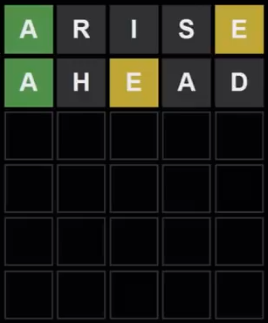
Jimmy Fallon: Second word
ian@hp:~$ python wordle_assistant.py
Total words is: 12972
Enter the letters NOT in the word ~ Dark Grey:rishd
Total words remaining: 1872
Enter the letters in the word ~ Yellow and Green:ae
Total words remaining: 359
Yellow letters:
1st position in the word [ a e ]:
2nd position in the word [ a e ]:
3rd position in the word [ a e ]:e
4th position in the word [ a e ]:
5th position in the word [ a e ]:e
Total words remaining: 153
Green letters:
1st position in the word [ a e ]:a
2nd position in the word [ a e ]:
3rd position in the word [ a e ]:
4th position in the word [ a e ]:
5th position in the word [ a e ]:
Total words remaining: 11
abbey ablet aglet agley allel alley angel annex apnea appel
axmen

Slide 9
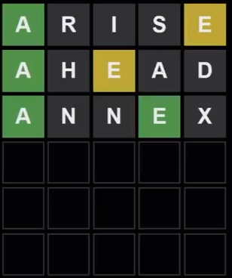
Jimmy Fallon: Third word
ian@hp:~$ python wordle_assistant.py
Total words is: 12972
Enter the letters NOT in the word ~ Dark Grey:rishdnx
Total words remaining: 1236
Enter the letters in the word ~ Yellow and Green:ae
Total words remaining: 245
Yellow letters:
1st position in the word [ a e ]:
2nd position in the word [ a e ]:
3rd position in the word [ a e ]:e
4th position in the word [ a e ]:
5th position in the word [ a e ]:e
Total words remaining: 97
Green letters:
1st position in the word [ a e ]:a
2nd position in the word [ a e ]:
3rd position in the word [ a e ]:
4th position in the word [ a e ]:e
5th position in the word [ a e ]:
Total words remaining: 7
abbey ablet aglet agley allel alley appel

Slide 10
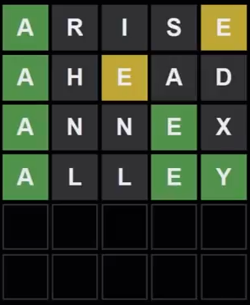

Jimmy Fallon: Fourth word
ian@hp:~$ python wordle_assistant.py
Total words is: 12972
Enter the letters NOT in the word ~ Dark Grey:rishdnxl
Total words remaining: 647
Enter the letters in the word ~ Yellow and Green:aey
Total words remaining: 26
Yellow letters:
1st position in the word [ a e y ]:
2nd position in the word [ a e y ]:
3rd position in the word [ a e y ]:e
4th position in the word [ a e y ]:
5th position in the word [ a e y ]:e
Total words remaining: 21
Green letters:
1st position in the word [ a e y ]:a
2nd position in the word [ a e y ]:
3rd position in the word [ a e y ]:
4th position in the word [ a e y ]:e
5th position in the word [ a e y ]:y
Total words remaining: 1
abbey

Slide 11
Starting with words that eliminate all vowels and Y
Example 1: AUDIO and YELPS
Example 2: BAYOU and INSET

Slide 12
Jimmy Fallon: but with AUDIO, YELPS
IF AUDIO and YELPS were first two words Include: AEIOU + Y
ian@hp:~$ python wordle_assistant.py
Total words is: 12972
Enter the letters NOT in the word ~ Dark Grey:udiolps
Total words remaining: 974
Enter the letters in the word ~ Yellow and Green:aye
Total words remaining: 52
Yellow Letters:
1st position in the word [ a y e ]:y
2nd position in the word [ a y e ]:e
3rd position in the word [ a y e ]:
4th position in the word [ a y e ]:
5th position in the word [ a y e ]:
Total words remaining: 32
Green Letters:
1st position in the word [ a y e ]:a
2nd position in the word [ a y e ]:
3rd position in the word [ a y e ]:
4th position in the word [ a y e ]:
5th position in the word [ a y e ]:
Total words remaining: 5
abbey arefy avyze aygre azyme

Slide 13
Jimmy Fallon: but with BAYOU, INSET
If BAYOU and INSET were first two words Include: AEIOU + Y
ian@hp:~$ python wordle_assistant.py
Total words is: 12972
Enter the letters NOT in the word:ouinst
Total words remaining: 1303
Enter the letters in the word ~ Yellow and Green:baye
Total words remaing: 13
Yellow letters:
1st position in the word [ b a y e ]:b
2nd position in the word [ b a y e ]:a
3rd position in the word [ b a y e ]:y
4th position in the word [ b a y e ]:
5th position in the word [ b a y e ]:
Total words remaining: 3
Green letters
1st position in the word [ b a y e ]:
2nd position in the word [ b a y e ]:
3rd position in the word [ b a y e ]:
4th position in the word [ b a y e ]:e
5th position in the word [ b a y e ]:
Total words after position dependent letters: 1
abbey

Slide 14
11 Feb 2022: BAYOU, INSET. Still 66 left...
ian@hp:~$ python wordle_assistant.py
Total words is: 12972
Enter the letters NOT in the word ~ Dark Grey:bayoinst
Total words remaining: 337
Enter the letters in the word ~ Yellow and Green:ue
Total words remaining: 124
Yellow letters:
1st position in the word [ u e ]:
2nd position in the word [ u e ]:
3rd position in the word [ u e ]:
4th position in the word [ u e ]:
5th position in the word [ u e ]:u
Total words remaining: 123
Green letters:
1st position in the word [ u e ]:
2nd position in the word [ u e ]:
3rd position in the word [ u e ]:
4th position in the word [ u e ]:e
5th position in the word [ u e ]:
Total words remaining: 66
clued cruel culex cumec cupel cured curer cuvee duded duked
duped duper dured euked feued flued fumed fumer fuzed fuzee
glued gluer grued gruel huger juked julep jurel kugel luged
luger lured lurer lurex luxed luxer muled mured murex muxed
pucer puked puker puled puler pured puree purer puzel queer
ruder ruled ruler rupee udder ugged ulcer ummed umped upled
upped upper urdee urged urger urped

Slide 15
11-Feb-2022: BAYOU, INSET, GLUED
ian@hp:~$ python wordle_assistant.py
Total words is: 12972
Enter the letters NOT in the word ~ Dark Grey:bayoinstgd
Total words remaing: 181
Enter the letters in the word ~ Yellow and Green:lue
Total words remaining: 25
Yellow letters:
1st position in the word [ l u e ]:
2nd position in the word [ l u e ]:
3rd position in the word [ l u e ]:u
4th position in the word [ l u e ]:
5th position in the word [ l u e ]:u
Total words remaining: 18
Green letters:
1st position in the word [ l u e ]:
2nd position in the word [ l u e ]:l
3rd position in the word [ l u e ]:
4th position in the word [ l u e ]:e
5th position in the word [ l u e ]:
Total words remaining: 1
ulcer

Slide 16
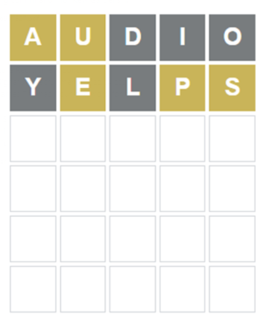
AUDIO, YELPS – 5 Letters, but wrong positions

Slide 17
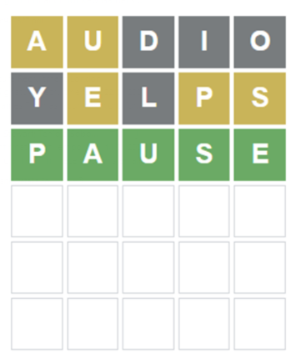
AUDIO, YELPS
ian@hp:~$ python wordle_assistant.py
Total words is: 12972
Enter the letters NOT in the word ~ Dark Grey:dioyl
Total words remaining: 2925
Enter the letters in the word:aueps
Total words remaining: 1
Orange letters:
1st position in the word [ a u e p s ]:a
2nd position in the word [ a u e p s ]:eu
3rd position in the word [ a u e p s ]:
4th position in the word [ a u e p s ]:p
5th position in the word [ a u e p s ]:s
Total words remaining: 1
Green Letters:
1st position in the word [ a u e p s ]:
2nd position in the word [ a u e p s ]:
3rd position in the word [ a u e p s ]:
4th position in the word [ a u e p s ]:
5th position in the word [ a u e p s ]:
Total words after position dependent letters: 1
pause

Slide 18

BAYOU, INSET
ian@hp:~$ python wordle_assistant.py
Total words is: 12972
Enter the letters NOT in the word ~ Dark Grey:byoint
Total words remaining: 2445
Enter the letters in the word ~ Yellow and Green:ause
Total words remaining: 15
Yellow Letters:
1st position in the word [ a u s e ]:
2nd position in the word [ a u s e ]:
3rd position in the word [ a u s e ]:s
4th position in the word [ a u s e ]:e
5th position in the word [ a u s e ]:u
Total words remaining: 12
Green Letters:
1st position in the word [ a u s e ]:
2nd position in the word [ a u s e ]:a
3rd position in the word [ a u s e ]:
4th position in the word [ a u s e ]:
5th position in the word [ a u s e ]:
Total words remaining: 5
cause hause pause salue sauce

Slide 19
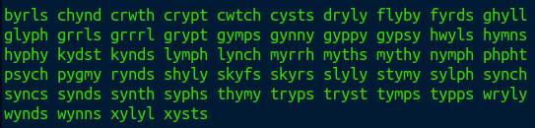
Wordle Utility program:
Data:
Total words = 12972
Total words without vowels = 54
Four vowels (or Y) in a word = 20

Slide 20
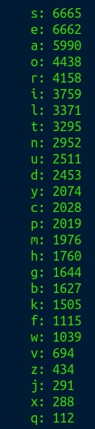
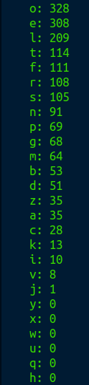
Wordle Utility Program:
Occurrence of letters:
Occurrence of pairs of letters:

Slide 21
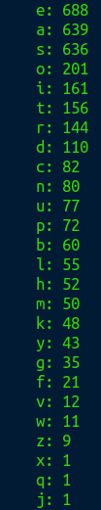
Wordle Utility Program:
Occurrence of same letter - Non-adjacent:

Slide 22


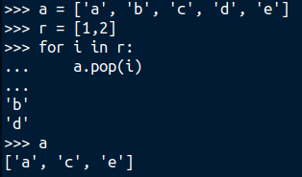
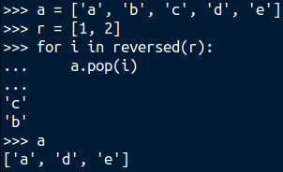
Python Code Snippets:
worlde_assistant.py at HamPUG Github repository: https://github.com/HamPUG/meetings/tree/master/2022/2022-02-14
Total words = 12,972:
Remove duplicates:
Pop from a list in reverse:

Slide 23
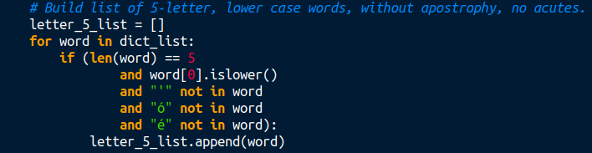
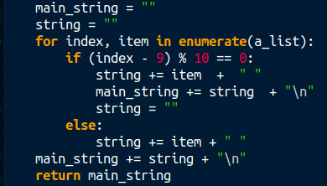
Python Code Snippets:
$ worlde_assistant.py --verbose OR -v
From Linux /usr/share/dict/british-english:
10 words to a line:

Slide 24
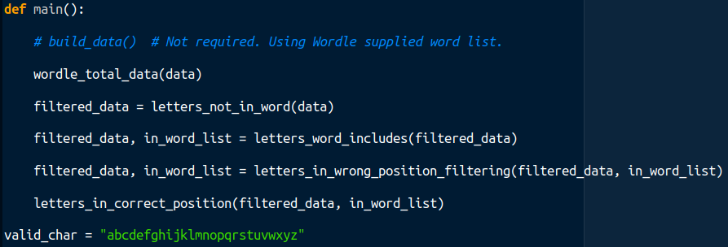
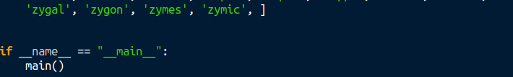
Python Code Snippets:
Set of functions:

Slide 25
Play todays Wordle Game:
Website: https://www.powerlanguage.co.uk/wordle/
which re-directs to: https://www.nytimes.com/games/wordle/index.html

